Slide 1

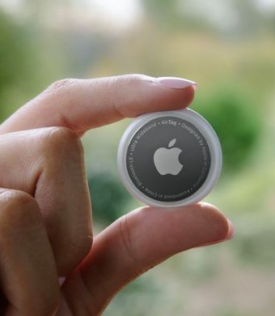
Apple Airtags
By Ruben Jamart
1

Slide 2



2
Notes:
Stealing
Car jacking
Being followed

Slide 3






5 subjects
3

Slide 4
What is it?
4

Slide 5
How does it work?
5

Slide 6
Why dangerous?
6

Slide 7
Safety
7
Notes:
Apple updates + what to do

Slide 8
Who’s in fault?
8

Slide 9
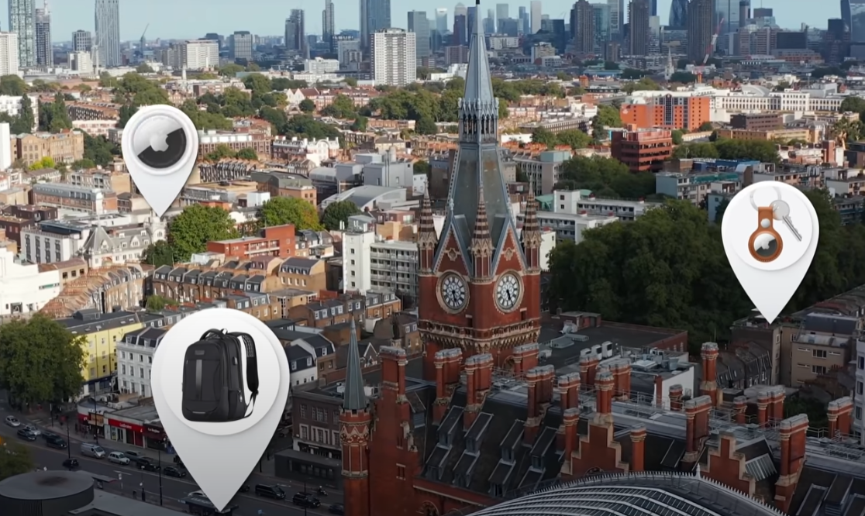
What is it?
2021
Tiny chips
Track location
29/piece
Fit anywhere
Track anywhere
Pin point accuracy
9

Slide 10

How does it work?
Speaker
Antennae
Bluetooth
Apple’s U1 Chip
Replaceable battery
10
Notes:
Before click: no gps explanation

Slide 11
How does it work?
Inexpensive
Batterylife: 1 year
No communication network
11

Slide 12
How does it work?
GPS signal from *ANY*
Apple product
Only Bluetooth signal
Picked up by anyone
10m radius
12
Notes:
Constant bluetooth signal checking which device is closest and sends the location of that device to the user

Slide 13
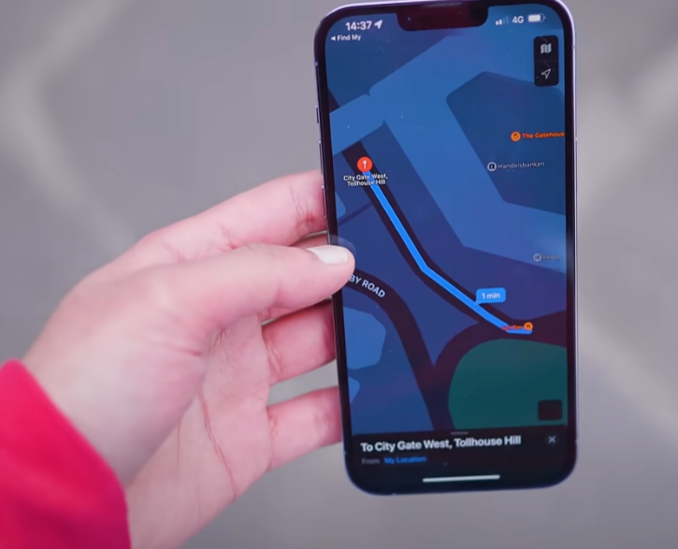
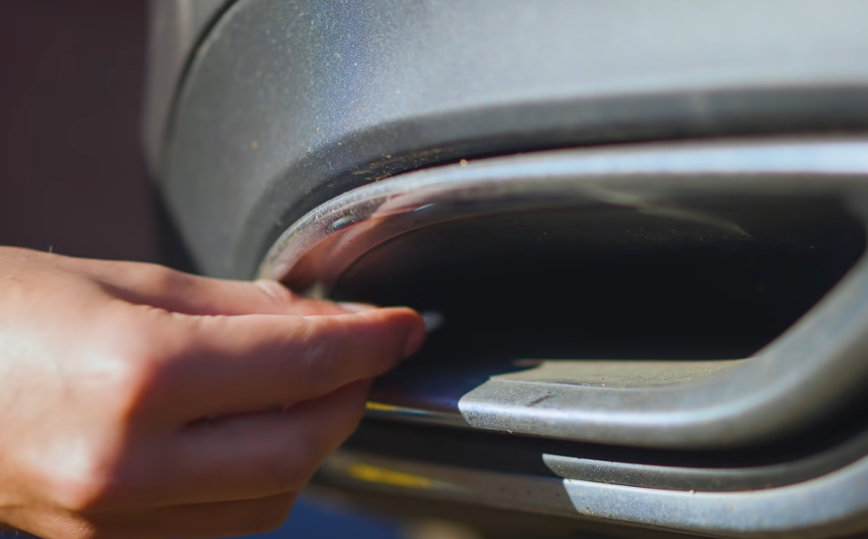
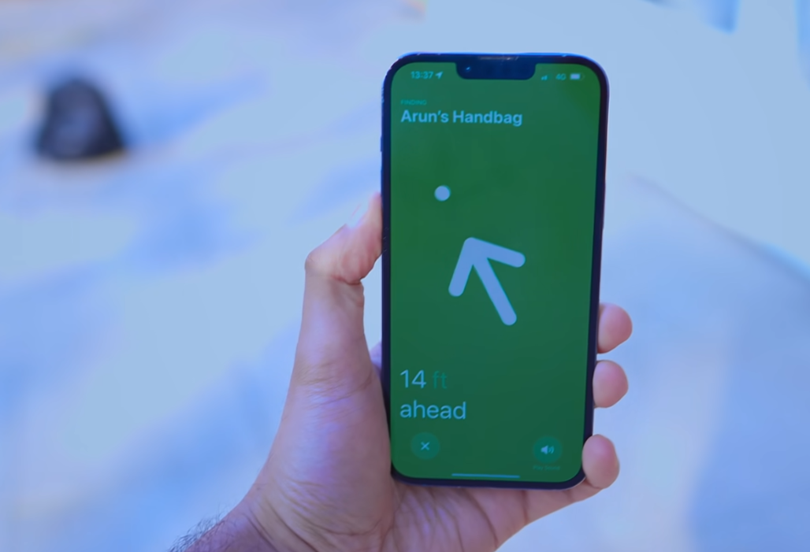
Why dangerous?
Can stick anywhere
Nearly invisible
Can follow anywhere
POINTED directions
Because U1 chip
13
Notes:
Click: 2 OPTIONS TO TRACK
YOU GET LITERAL DIRECTIONS WHAT??

Slide 14

Why dangerous?
14
Notes:
INSIDE SOMEONES CAR

Slide 15

Why dangerous?
15
Notes:
BEHIND LICENSE PLATE

Slide 16
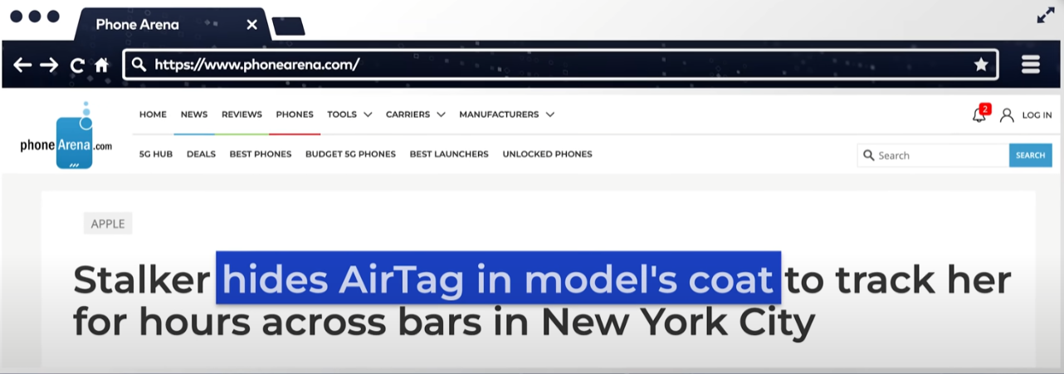
Why dangerous?
16
Notes:
SOMEONES COAT

Slide 17

Safety
Apple → updates to
solve issue
(F.e. beeps)
Problem: Removing speakers
Unreliable software
17
Notes:
CLICK ONCE: APPEAR
CLICK TWICE: DISAPPEAR
Unreliable software: let’s explain why

Slide 18
Safety
Notification sometimes
Actual notification?
*DO NOT GO HOME*
Check pockets
Remove battery:
Disable tracking
Keep tag
Go to police
18

Slide 19
Safety
MORE PROBLEMS?
Android??
Unreliable app: Tag tracker
Inconsistent
Does not run in background
19

Slide 20
Who’s in fault?
Apple = NOT the first
Too easy
Is it really their fault?
20

Slide 21
Conclusion
Seen tests: Very scary
100% reliable tracking
Check pockets more often
Make sure you’re not followed
Stay safe
The end
21

